Slide 1
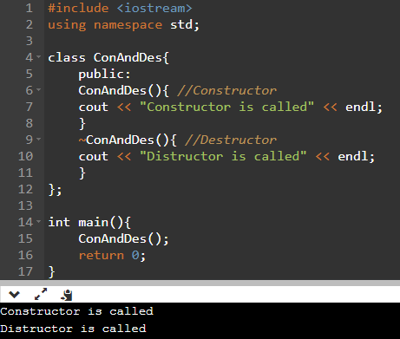
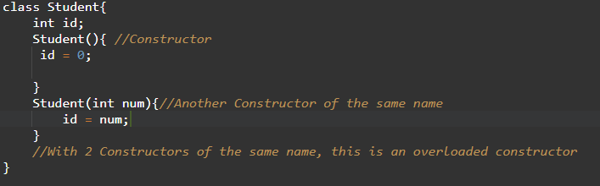
Overloading Constructors | Destructors
Overloaded Constructor: 2 or more Constructors that accept different
Used to make your Classes more user friendly
Destructor: Called when program ends
Used to delete any dynamically allocated info before closing program to not take up space on your computer

Slide 2
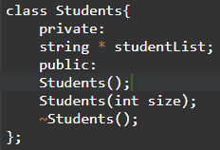
Make the 2 Constructors as well as the Destructor for the Students class
For the default constructor make studentList null;

Slide 3
